Slide 1
iOS
UI Components
Sisoft Technologies Pvt Ltd
SRC E7, Shipra Riviera Bazar, Gyan Khand-3, Indirapuram, Ghaziabad
Website: www.sisoft.in Email:info@sisoft.in
Phone: +91-9999-283-283

Slide 2
Types of Views
View category | Purpose | Examples of views
Content | Display a particular type of content, such as an image or text. | Image view, label
Collections | Display collections or groups of views. | Collection view, table view
Controls | Perform actions or display information. | Button, slider, switch
Bars | Navigate, or perform actions. | Toolbar, navigation bar, tab bar
Input | Receive user input text. | Search bar, text view
Containers | Serve as containers for other views. | View, scroll view
Modal | Interrupt the regular flow of the app to allow a user to perform an action. | Action sheet, alert view

Slide 3
Labels
NSObject->UIResponder->UIView->UILabel
The UILabel class implements a read-only text view.
Properties
text
textColor
numberOfLines
Creating Programatically
UILabel *sLabel = [[UILabel alloc] initWithFrame:CGRectMake(20,300,100,60)] ;

Slide 4
UIButton
NSObject->UIResponder->UIView->UIControl->UIButton
Implements a button that intercepts touch events and sends an action message to a target object when it's tapped
You can set the title, image, and other appearance properties of a button
In addition, you can specify a different appearance for each button state.

Slide 5
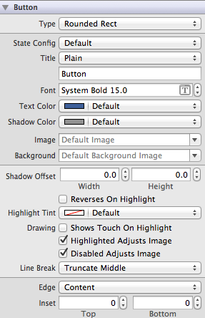
UIButton…
Common action Touch Up Inside
Inspector window showing various properties

Slide 6
UIButton…
A button sends the UIControlEventTouchUpInside event when the user taps it. You can respond to this event by performing some corresponding action in your app, such as saving information. You register the target-action methods for a button as shown below.
[self.myButton addTarget:self action:@selector(myAction:)
forControlEvents:UIControlEventValueChanged];

Slide 7
Text Field
NSObject->UIResponder->UIView->UIControl->UITextField
A UITextField object is a control that displays editable text
When the user taps in a text field, that text field becomes the first responder and automatically asks the system to display the associated keyboard
To dismiss the keyboard, send the resignFirstResponder message to the text field that is currently the first responder.

Slide 8
Text Field
Properties
text
Placeholder
Font
textColor

Slide 9
Text View
NSObject->UIResponder->UIView->UIScrollView->UITextView
The UITextView class implements the behavior for a scrollable, multiline text region. The class supports the display of text using custom style information and also supports text editing.

Slide 10
ImageView
NSObject->UIResponder->UIView->UIImageView
An image view object provides a view-based container for displaying either a single image or for animating a series of images.
Initialization : - initWithImage
Properties
image
highlightedImage

Slide 11
UISlider
NSObject->UIResponder->UIView->UIControl->UITextField
UISlider displays a horizontal bar, called a track, that represents a range of values
The current value is shown by the position of an indicator, or thumb
A user selects a value by sliding the thumb along the track
You can customize the appearance of both the track and the thumb.

Slide 12
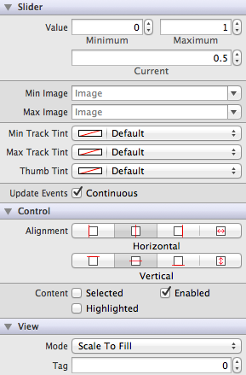
UISlider….
Common action Value Changed
Inspector window showing various properties

Slide 13
UISlider….
Properties
Value
minimumValue
maximumValue

Slide 14
UISwitch
NSObject->UIResponder->UIView->UIControl->UISwitch
class to create and manage the On/Off buttons used
The UISwitch class declares a property and a method to control its on/off state
when the user manipulates the switch control (“flips” it) a UIControlEventValueChanged event is generated, which results in the control (if properly configured) sending an action message

Slide 15
UISegmentedControl
NSObject->UIResponder->UIView->UIControl->UISegmentedControl
Displays an element that comprises multiple segments
Each of which functions as a discrete button Each segment can display either text or an image, but not both
UISegmentedControl ensures that the width of each segment is proportional, based on the total number of segments, unless you set a specific width.

Slide 16
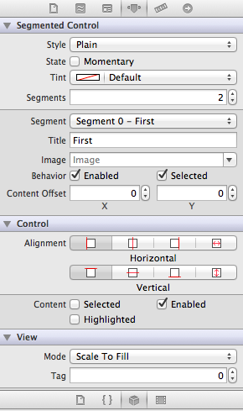
UISegmentedControl…
Common action Value Changed
Inspector window showing various properties

Slide 17
Keyboard Inputs

Slide 18
Selecting Keyboard Type For Text Field

Slide 19
Types of Keyboard
Default
NumberPad
DecimalPad
PhonePad
NumberPhonePad
E-mail Address
Url
Twitter
Numbers And Punctuations
ASCII Capable

Slide 20
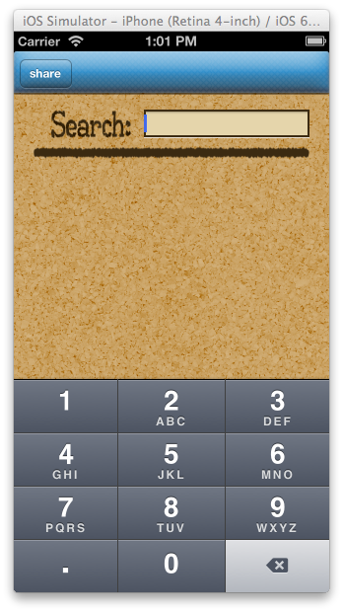
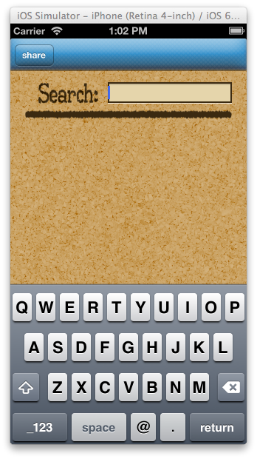
Defaault,Decimal And E-Mail Pad Look

Slide 21
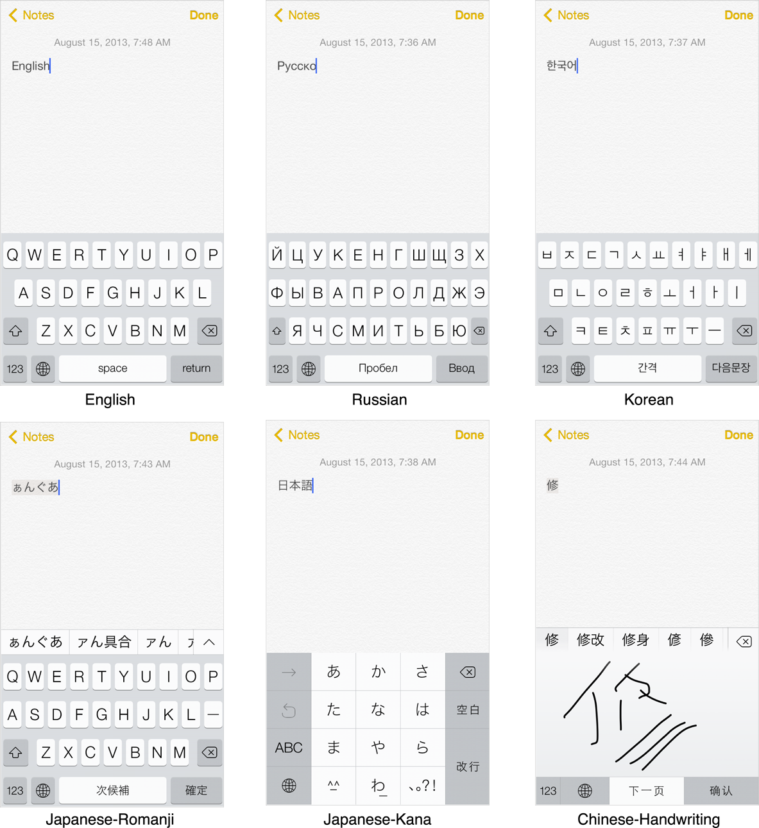
Several different keyboards and input methods

Slide 22
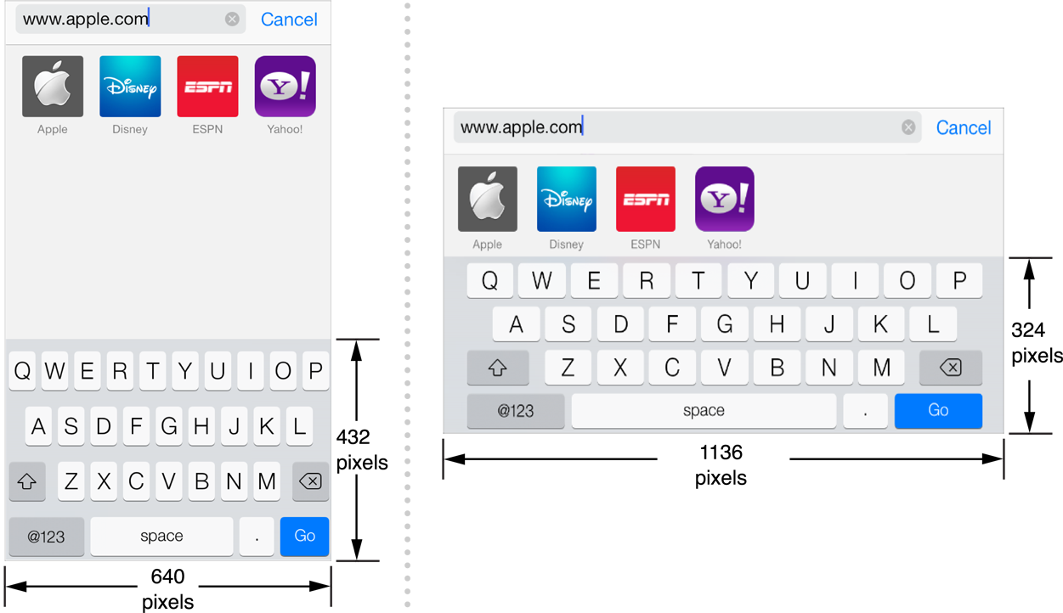
Relative keyboard sizes in portrait and landscape modes

Slide 23
Keyboard Method
In Objective-C there are several method related to keyboard.
There are delegate method for keyboard that handle the keyboard properties.
Loading the keyboard.
Hiding the keyboard.
Show the keyboard automatically.

Slide 24
Some Code
[textBoxName sendMessage];
Displaying the Keyboard:
[textField becomeFirstResponder];
Dismissing the Keyboard
[textField resignFirstResponder];
Notification
-(void)keyboardDoneObserver: (NSNotification*)notification
For more on working with keyboard visit link:
https://developer.apple.com/library/ios/documentation/StringsTextFonts/Conceptual/TextAndWebiPhoneOS/KeyboardManagement/KeyboardManagement.html

